Slide 1

Let’s Reunite.
Team Name: Elite Hackers
City: Bengaluru

Slide 2
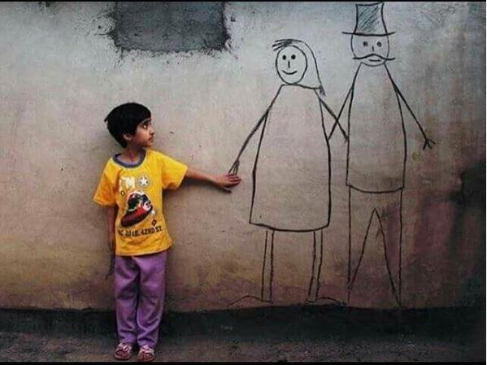
Statistics
A deeply disturbing fact about India’s missing children is that while on an average 174 children go missing every day, half of them remain untraced. (Deccan Chronicle)
The complaints are generally filed after two or three days as the family waits for a while thinking that they would return, and then they try on their own to search with the help of their relatives and friends. (newindianexpress)

Slide 3
“Most of the missing children are trafficked for labor, for sexual exploitation, abducted, or kidnapped.. They could be runaways from home, or simply be lost," said a government statement.(cyprus-mail)
India currently has almost 2 lakh [200,000] missing children and about 90,000 lodged in various child care institutions. told The Better India.

Slide 4
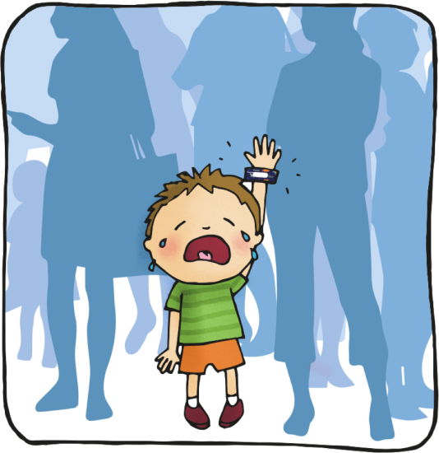

Scenario: Suppose you see a child on street/market and you feel he/she is lost, how will you help that child?

Slide 5

But what if the child is deaf & dumb?

Slide 6
What if there was a Smarter way, A better way to help such children by using technology ?

Slide 7

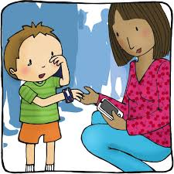
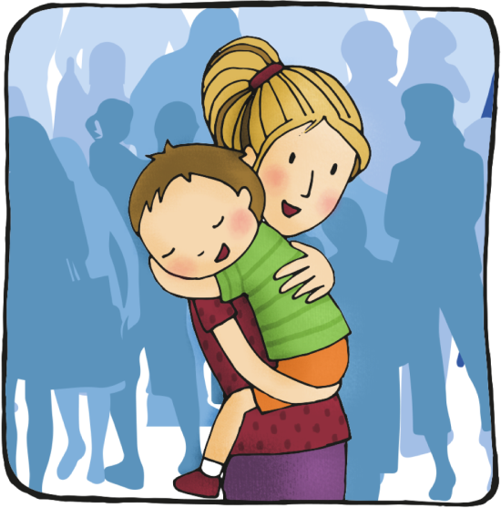
Let’s Reunite.
Identify can be used by both parents to report missing children and by citizens to report about any vulnerable child on the streets with details and pictures & it can also be used by police officials. The site will connect to databases and use facial recognition find a probable match, allowing him/her to see the whereabouts of the child.

Slide 8
Prototype

Slide 9
Future Enhancements
Enhanced Police Module: since there are security issues so police intervention is required & only authorized police can login and verify the profile details.
Fingerprint/Face Scan: with the help of Govt and using their aadhaar database the site will be able to identify a person by just scanning the person’s finger print or face.
App development: IOS/Android apps.

Slide 10
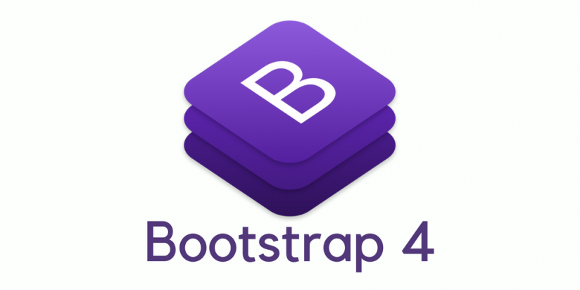





Technologies ?

Slide 11
Cost Structure:
Development (One Time) : No. of heads working on it, for what time? Include developers salaries per month. (50,000rs)
Maintenance (Recurring) :
Approx. Cost estimation for 1 million user base.
Database: if we consider 1 user takes 500kb of data, for 1m users 50gb approx. storage is required. (500rs) per/month
Server : During registration user makes one POST request, while fetching details user makes one GET request. (1,08,000rs approx.) per/month, pay as you use.
API’s : Cognitive Services Face Recognition API cost per invocation. Lets consider one user makes one request. (52,877rs) for 1m – 5m transactions.
Marketing/Promotions: (depending on time)
Awareness Channels (Govt. Agencies, Ads, Digital Media, Police)
(1,00,000rs budget)
Total : 1,13,000rs per/month (maintenance)
Approx. 1,50,000rs one time development and marketing cost.

Slide 12
Conclusion: Identify is a web application, which allows us to share the picture and details of people you see on road side, and feel they are lost. Kids and old people who are forced into begging or kidnapped and being used for several illegal activities can find their way back home. Files of FIRs are filled with such cases, however best possible way to get them back to their home is using the technologies to make them meet their families. Even if we can do it for one of them, our purpose is solved.

